Slide 1
Support Vector Machine
Find a linear hyperplane (decision boundary) that will separate the data

Slide 2
Support Vector Machine
One Possible Solution

Slide 3
Support Vector Machine
Another possible solution

Slide 4
Support Vector Machines
Other possible solutions

Slide 5
Support Vector Machine
Which one is better? B1 or B2?
How do you define better?

Slide 6
Support Vector Machines (big margin classifier)
Find hyperplane maximizes the margin => B1 is better than B2
Notes:
去找超平面的margin 最大值

Slide 7
Where is the line relative to the origin?
X2
“⋅” is the inner product operation
x is the position vector of a point on the line.
X1
此條線為由原點沿
Going from the origin along the w direction
for –b/|w| distance; w is a normal vector of
the line.
方向走
與 垂直的線

Slide 8
Support Vector Machines

Slide 9
This line can be found along the
normal vector w and
is –b/|w| away from the origin.
W⋅X +b =0
此線在沿法向量走-b/|w|的距離，與法向量垂直
w•x+b=0
x₁-x₂
x₁
d
x₂
w
w⋅x+b=1
w⋅x+b = -1
0

Slide 10
w⋅x₁ + b=1 (1)
w⋅x₂ + b = -1 (2)
(1) – (2):
w⋅(x₁-x₂) = 2
||w|| ||x₁-x₂|| cos =2
Since ||x₁-x₂|| cos = d
d= 2/||w||, d is the margin that needed to be maximized

Slide 11
Some derivation
w⋅x+b=0 What is the orientation of the line ？
x_{a} , x_{b} two points on the line→ w⋅x_{a}+b=0 (1), w⋅x_{b}+b=0 (2)
(1) –(2), we have, w⋅(x_{a}-x_{b})=0 -> a vector on the line is normal to w; therefore, w is a normal vector of the line
Note that “⋅” denotes the inner product operation.
Denote square class by y=1, circle class by y=-1
Classification equation for z,

Slide 12
For any possible normal vector w, we can find the separation plane w ⋅x_{s}+b=0.
We can also find the two supporting planes w⋅x_{c}+b=k (away from origin ) and w⋅x_{c}+b=-k (closer to the origin)
Adjust w and b such that
w⋅(x₁-x₂)=2
||w||*d=2
⇨

Slide 13
Support Vector Machines
Find f(x) which maximize:
Which is equivalent to find f(x) that minimize:
subjected to the following constraints:
It is a constrained optimization problem
Numerical approaches to solve it (e.g., quadratic programming)

Slide 14
Min f(w)=
Subject to
Change to
Min f(w)=
Subject to

Slide 15
Linear SVM:Separable case
KKT conditions:

Slide 16
Replace (5.39) for w and (5.40) into (5.38)
we get:

Slide 17
Some important points
According to (5.42): λ_{i}> 0 only when
y_{i}(w⋅x_{i}+b)-1=0;
That is, only data point lies on the supporting plane are needed for determining w and b; these data points are called the support vectors.
The dual Lagrangian involves only the Lagrange multipliers and the training data, while the primary Lagrangian involves the Lagrange multipliers as well as parameters of the decision boundary.
The solutions for both optimization problems are equivalent.

Slide 18
The quadratic term in Equation 5.43 has a negative sign, which means that the original minimizatio problem of the primary Lagrangian LP, has turned into a maximization problem involving the dual Lagrangian, LD
The decision boundary can be expressed as
b can be found by equation (5.42) with only the support vectors

Slide 19
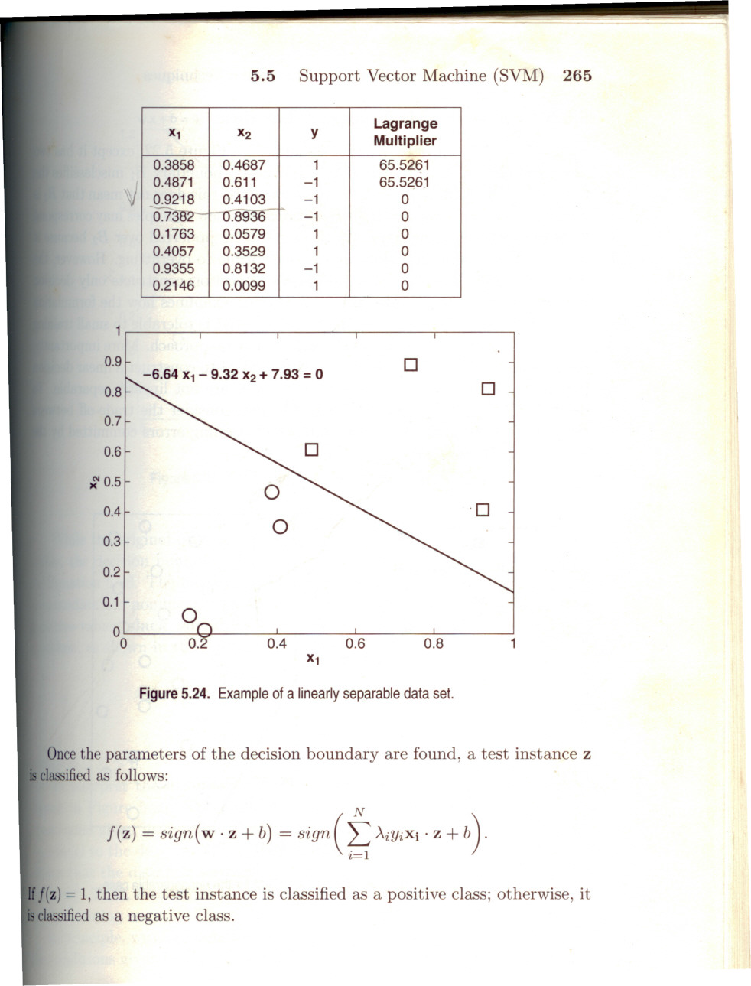
A linear separable example

Slide 20
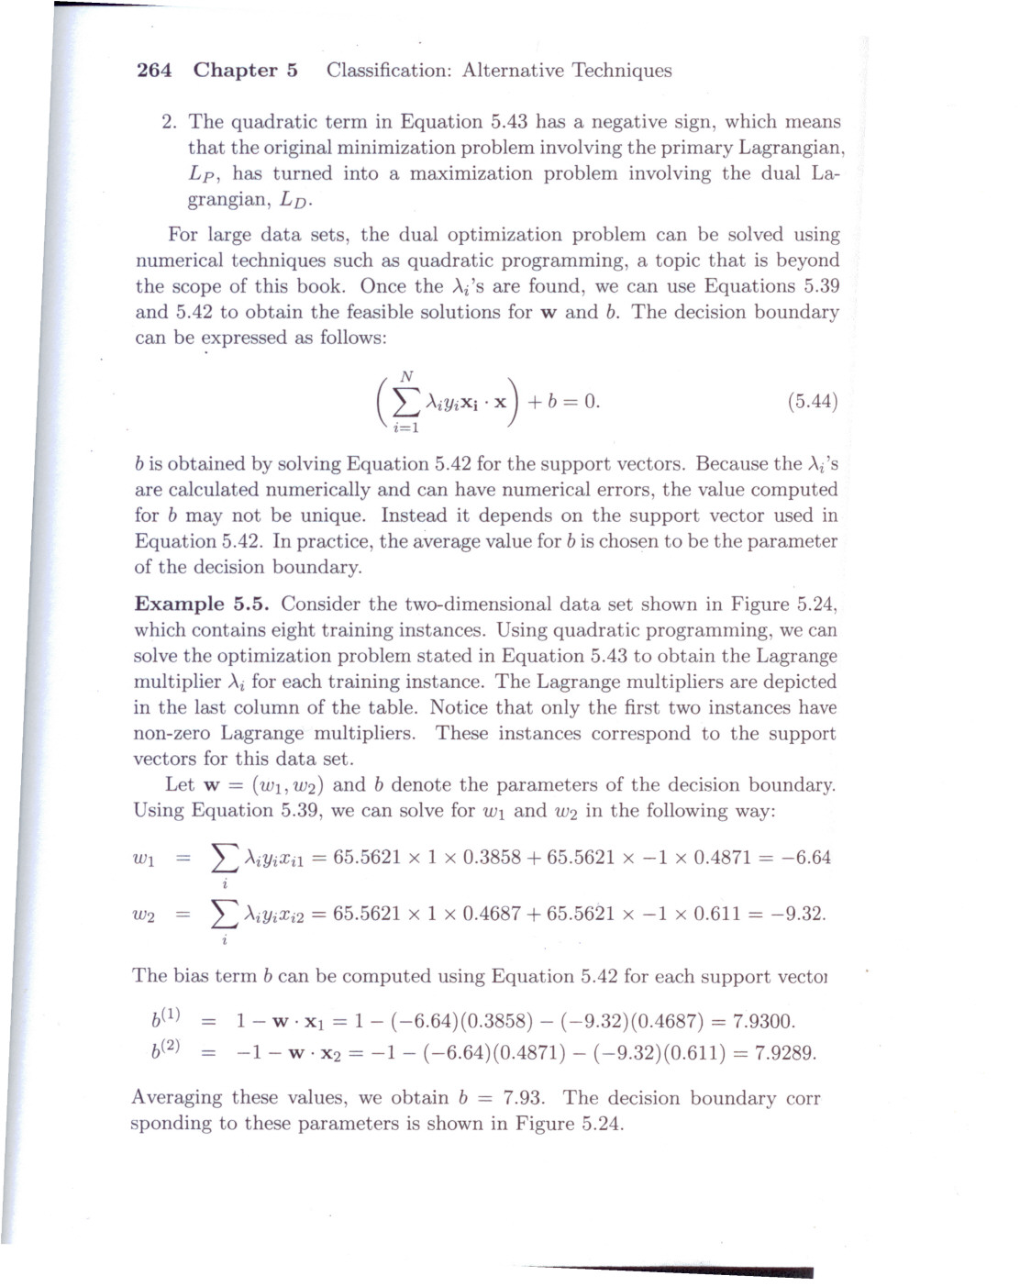

Slide 21
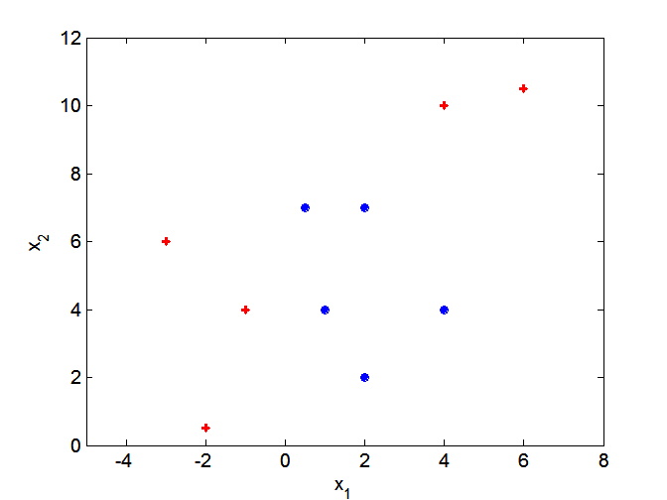
Nonlinear Support Vector Machines
What if decision boundary is not linear?

Slide 22
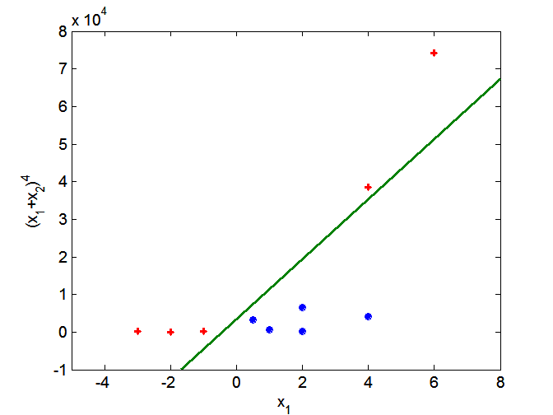
Nonlinear Support Vector Machines
Use mapping a func. φ to map data into another space

Slide 23
Nonlinear SVM
Min
Subject to y_{i} (wφ(x_{i})+b)≥0, i=1,2,…,N

Slide 25
To solve equation (56), we need to calculate
The inner product of two high dimensional vectors, it’s costly!
So, people come up with the kernel trick to simply the calculation of
Inner product of two mapped vectors.

Slide 26
Kernel Trick
Note that the mapping function is
A function of the inner product of two vectors. The function value is equal to the
inner product of the two mapped higher dimensional vectors.

Slide 27
Decision boundary with kernel function

Slide 28
Characteristics of SVM
The SVM learning problem can be formulated as a convex optimization problem, in which global optimal can be obtained.
SVM performs capacity control by maximizing the margin of the decision boundary. User must provide parameters such as the type of kernel function and the cost function C.
The SVM can be extended to multiclass problem.

Slide 29
Some background
Unconstrained optimization
Constrained optimization

Slide 30
Hessian matrices
Hessian matrices are used in large-scale optimization problems within Newton-type methods because they are the coefficient of the quadratic term of a local Taylor expansion of a function. That is,
y = f ( x + Δ x ) ≈ f ( x ) + ∇ f ( x ) ^{T} Δ x + 1/( 2 !)
(Δ x) ^{T} H ( x ) (Δ x)
where ∇f is the gradient (∂f/∂x₁, ..., ∂f/∂x_{n}).

Slide 31
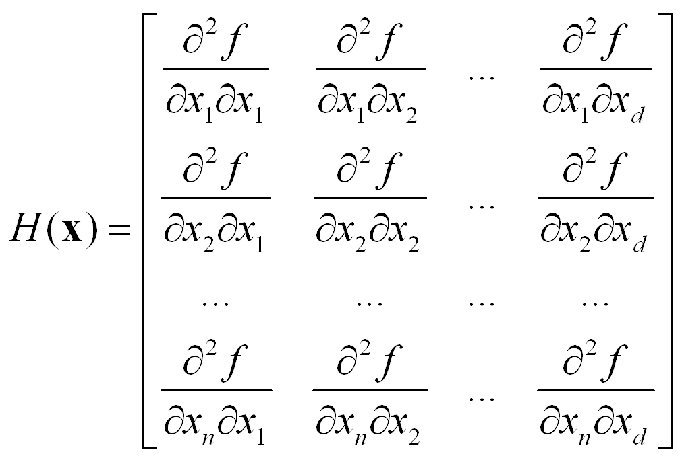

Slide 32
Example 1: f(x, y) = 3x²+ 2y³- 2xy
The condition to find the max. or min. are:
Whose solution is x*=y*=0 or x*=1/27, y*=1/9

Slide 33
The Hessian of f is
At x=y=0
Since [x,y]H(0,0)[x, y]^{T} =6x²-4xy =2x(3x-2y), which can be positive or negative, the Hessian is indefinite and (0,0) is a saddle point.

Slide 34
At x=1/27, y=1/9,
Since [x,y]H(1/27, 1/9)[x,y]^{t} =4x²-2xy+4y²/3=4(x-4y)² +13y²/12 >0, for non-zero x and y, the Hessian is positive definite. Therefore, (1/27, 1/9) is a minimum point. The min. value of f is
-0.0014.

Slide 35
Constrained optimization
Equality constraints
find minimum value of f(x1, x2, …, xd) subjected to equality constraints of the form:
g_{i}(x) = 0 , i= 1,2,…, p
A method known as Lagrange multipliers can be used to solve the constrained optimization. This method involves the following steps:
Define the Lagrangian, L(x, λ) = f(x) +
where λ_{I} is a dummy variable called the Lagrange multiplier.

Slide 36
2. Set the first-order derivatives of the Lagrangian with respect to x and the Lagrange multipliers with respect to x to zero,
and
3. Solve the (d+p) equations in step 2 to obtain the stationary point x* and the corresponding values for _{I}’s

Slide 37
Example E.2
Let f(x, y) = x+2y. Suppose we want to minimize the function f(x, y) subject to the constraint
x² + y² -4=0.
First , introduce the Lagrangian
then

Slide 38
Solving these equations yields:
When =
When  = -
Therefore, f(x,y) has its minimum value at

Slide 39
Inequality constraints:
finding the minimum value of f(x1,x2,…,xd) subjected to inequality constraints of the form:
Let
similar approach but more conditions known as the
Karush-Kuhn-Tucker (KKT) conditions:

Slide 40
Example E.3
Want to minimize the function f(x, y) = (x-1)²+(y-3)², subjected to
Lagrangian for this problem:
KKT:

Slide 41
Based on E.19 and E.20, we have four cases:
Case 1: ₁=0, ₂ =0 :
we have
2(x-1)=0 and 2(y-3) = 0
then x=1, y=3; x+y=4, violates the condition of
x+y <= 2
Case 2: ₁=0, ₂ ≠0
We have
x-y=0, 2(x-1) + ₂=0, 2(y-3) - ₂=0
Then x=2, y=2, and ₂ = -2: violates ₂ >= 0

Slide 42
Case 3: ₁≠0, ₂ =0:
We have
x+y-2=0, 2(x-1)+ ₁=0, -2(x+1) + ₁=0
Then
x=0, y=2, and ₁ =2
This is a feasible solution
Case 4: ₁≠0, ₂ ≠ 0:
We have x=1, y=1, ₁=2, and ₂=-2
Not a feasible solution. So the solution is x=0 and y=2

